Slide 1



a Large-scale Knowledge-base to Perform Visuo-semantic Queries over Wikimedia Commons Images
Sebastián Ferrada Aliaga
Foundations of Data Institute
Department of Computer Science
Universidad de Chile

Slide 2
1.
The Problem

Slide 3

How old is the Rock?
Notes:
notaaa

Slide 4
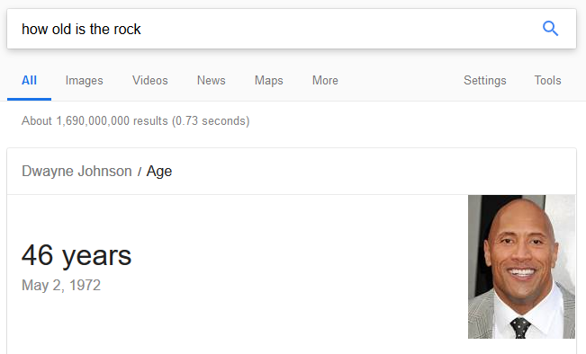

Slide 5
how long do rocks live?

Slide 6
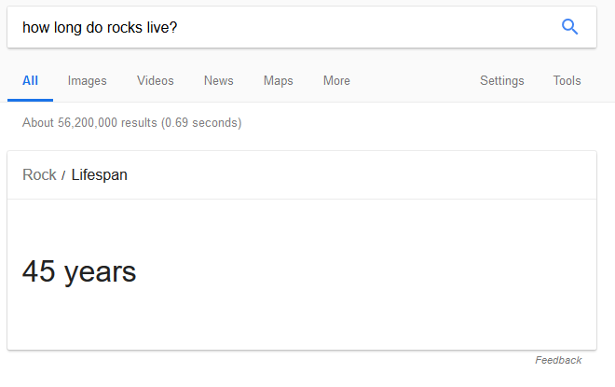
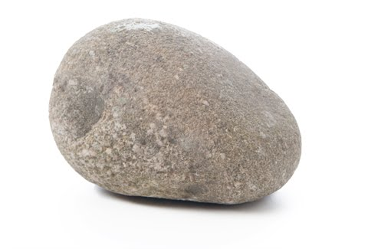


Slide 7


How is it posible for machines to understand sophisticated queries?
(Brazil, hasCapital, Brasilia)

Slide 8



Is it posible for machines to understand sophisticated queries?
SELECT ?lifespan ?img WHERE{
?rock db:hasLifespan ?lifespan;
db:image ?img.
}

Slide 9
How can these technologies be used to manage content-based similarity of multimedia resources?

Slide 10
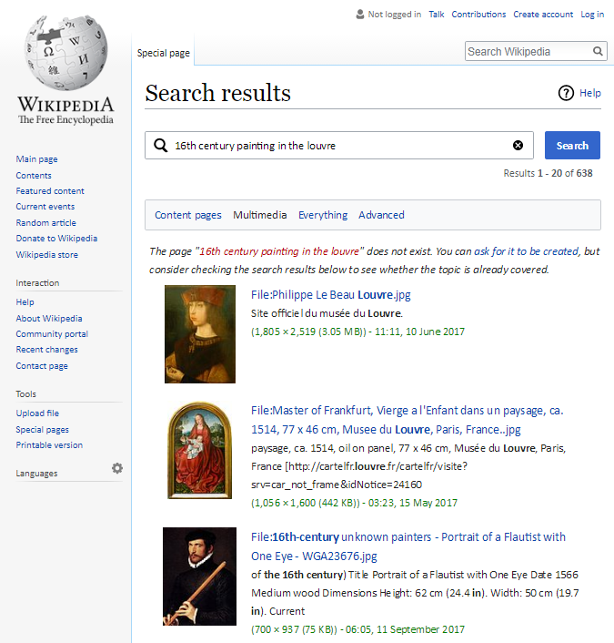
Are there paintings of the 16th century on display in the Louvre?

Slide 11
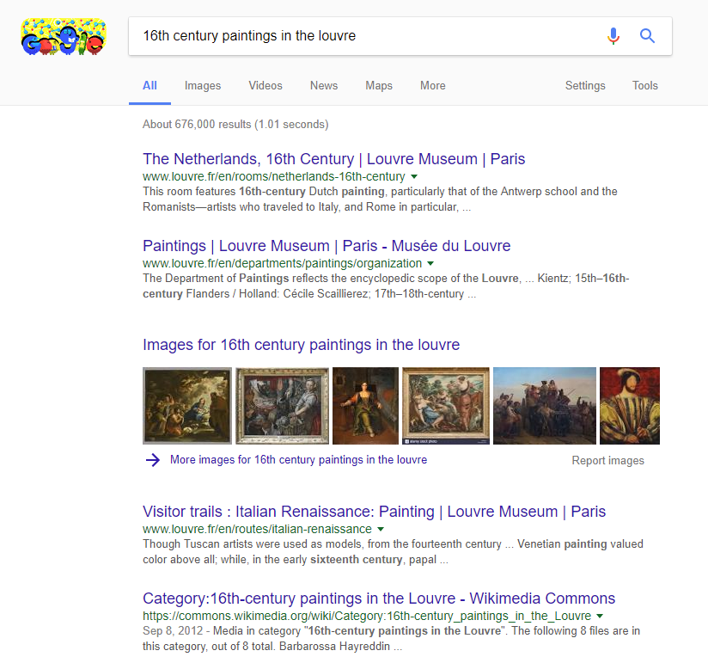
Are there paintings of the 16th century on display in the Louvre?

Slide 12
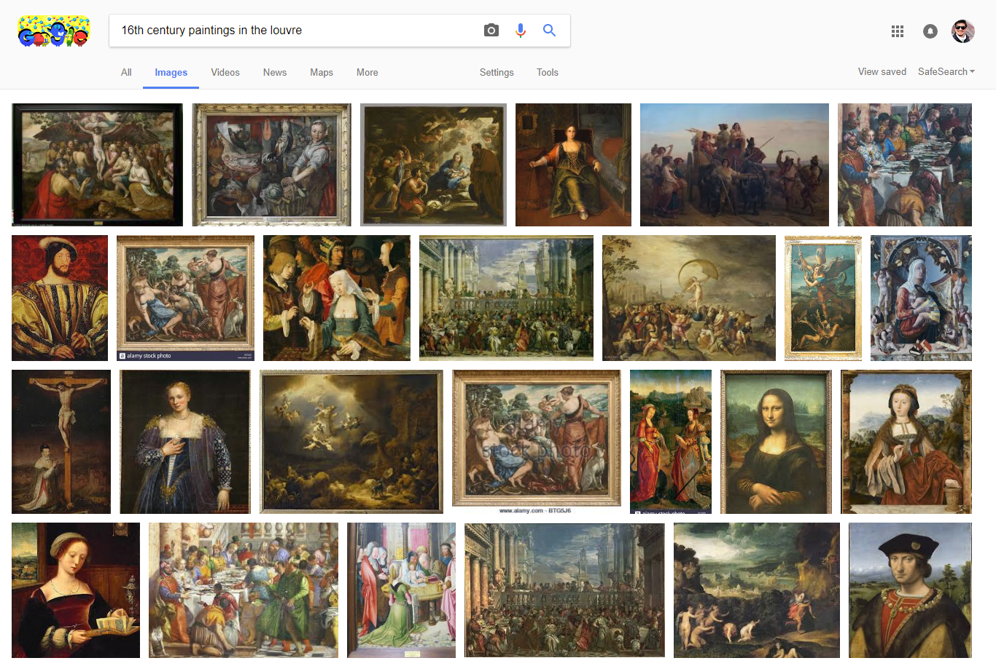
Are there paintings of the 16th century on display in the Louvre?

Slide 13
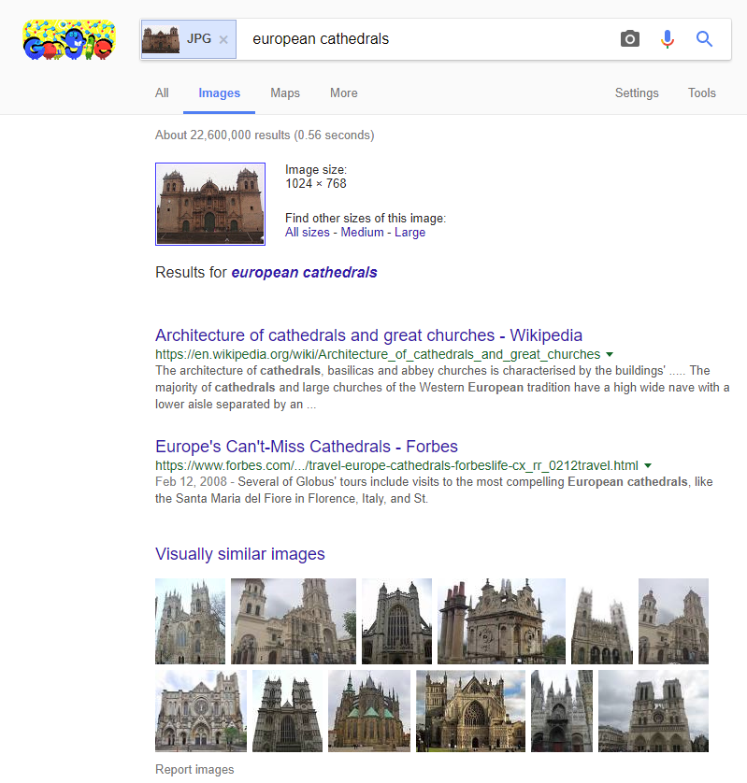
Are there European locations similar to the Cusco Cathedral?

Slide 14

There are many linked datasets for multimedia

Slide 15
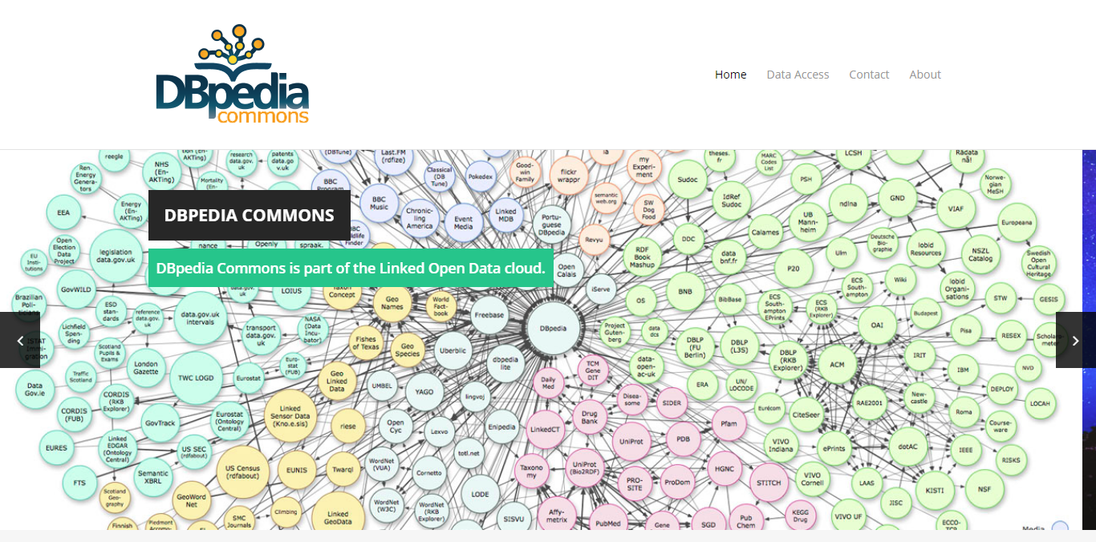
There are many linked datasets for multimedia

Slide 16
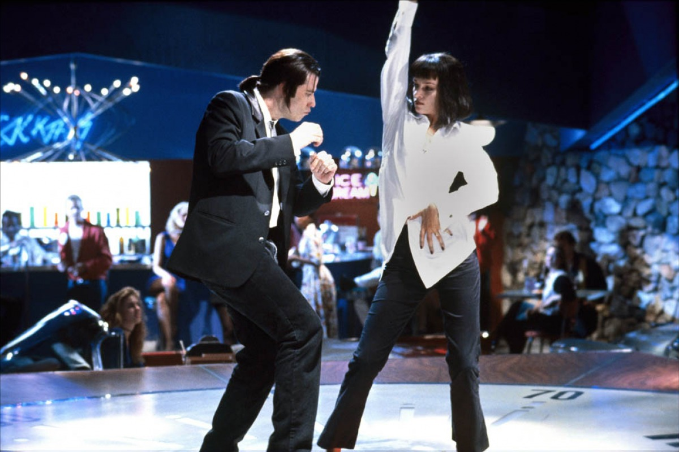
Focus on meta-data and manual annotations
height

Slide 17
Similarity search with SPARQL
Only text similarity
Too costly: all elements are compared to each other
There is also geodesic-distance-based proposals

Slide 18
2.
The Objective

Slide 19
To provide a means to combine semantic queries with visual-similarity queries

Slide 20
3.
The Methodology

Slide 21
Methodology
Image Processing
Obtain a local copy of images
Compute visual descriptors
Similarity Search
Find a suitable tool
Compute static similarity relations
Linked Data
Define an ontology
Parse raw data
Publish a SPARQL endpoint

Slide 22
4.
The Image Processing

Slide 23

Download Wikimedia Commons Images
14.7 million images (JPG and PNG)
22 TB

Slide 24



Reference Implementations of Visual Descriptors
Gray Histogram Descriptor (GHD)
Histogram of Oriented Gradients (HOG)
Color Layout Descriptor (CLD)
DeCAF7

Slide 25
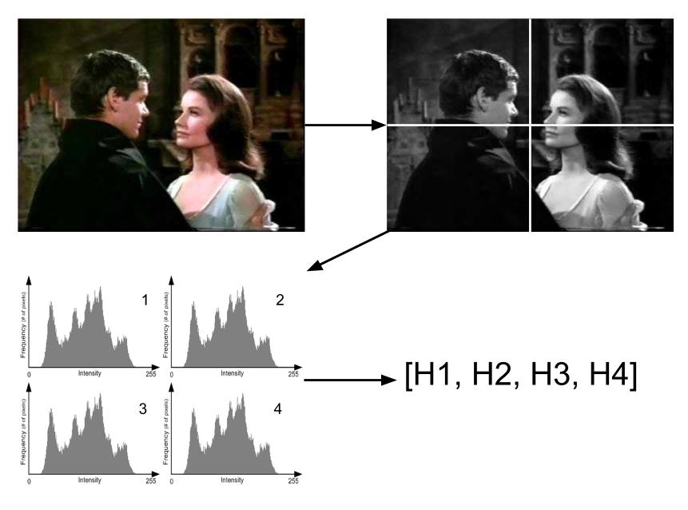
Gray Histogram Descriptor (GHD)

Slide 26
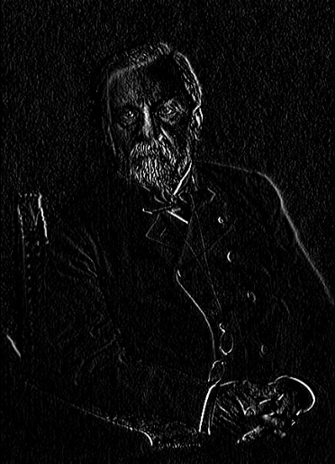
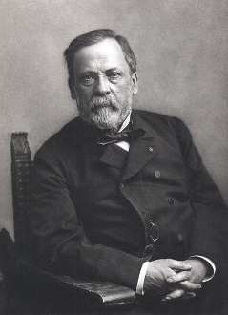
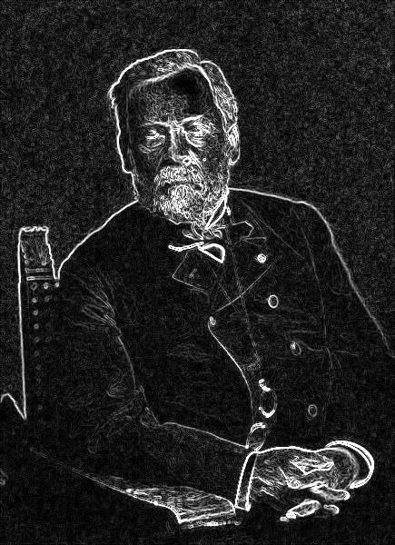
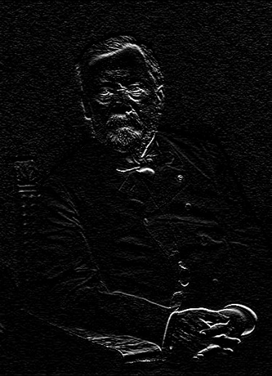
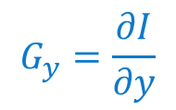
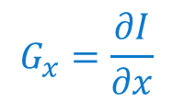

Histogram of Oriented Gradients (HOG)
$$G_{x}=\frac{∂I}{∂x}$$
$$\left\|\overset{⃑}{∇}I\right\|$$
$$G_{y}=\frac{∂I}{∂y}$$

Slide 27
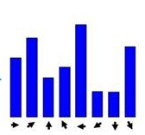

Histogram of Oriented Gradients (HOG)
$$θ\left(x,y\right)=\arctan{\frac{G_{y}}{G_{x}}}$$

Slide 28
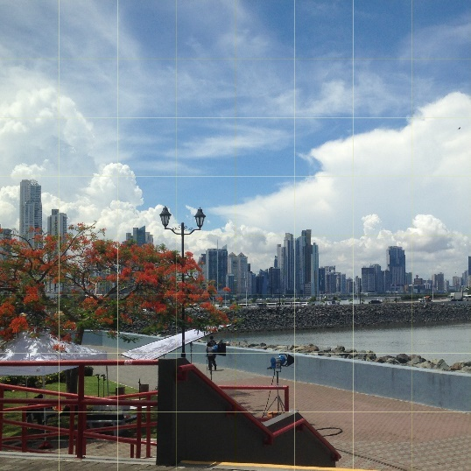

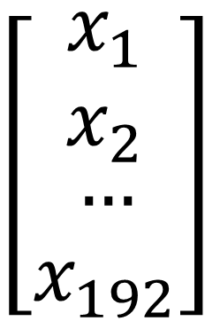
Color Layout Descriptor (CLD)
$$\left[\begin{matrix}\begin{aligned}x_{1} \\ x_{2}\end{aligned} \\ … \\ x_{192}\end{matrix}\right]$$
YUV
DCT

Slide 29

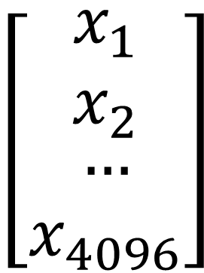
DeCAF7
$$\left[\begin{matrix}\begin{aligned}x_{1} \\ x_{2}\end{aligned} \\ … \\ x_{4096}\end{matrix}\right]$$

Slide 30
Descriptor Extraction
Descriptor | Average execution time [ms]
 | Single thread | Multithread
GHD | 119.4 | 10.4
HOG | 477.7 | 25.7
CLD | 436.7 | 30.4
DeCAF7 | 3634.8 | 3809.7
Notes:
We take a benchmark to evaluate the viability of the project

Slide 31
43 Hours
107 Hours
127 Hours
GHD
HOG
CLD
Non-viable
DeCAF7

Slide 32
5.
The Similarity Search

Slide 33
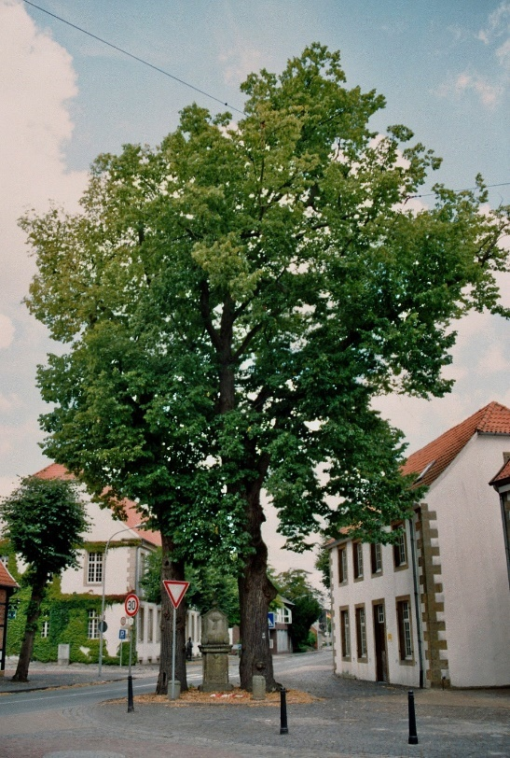
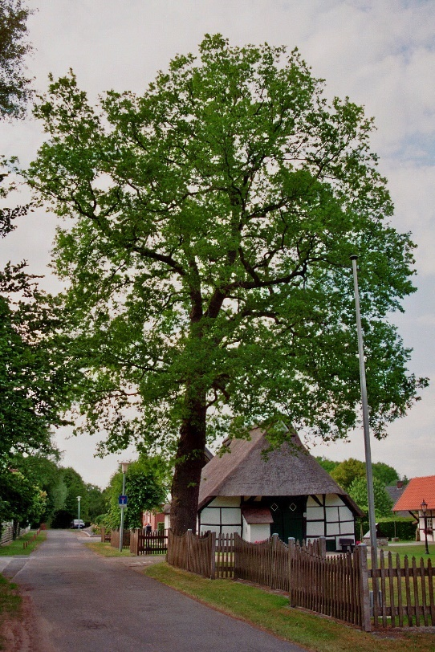
Goal
similar

Slide 34
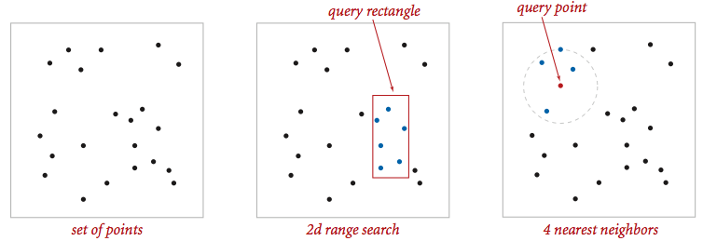
How?

Slide 35
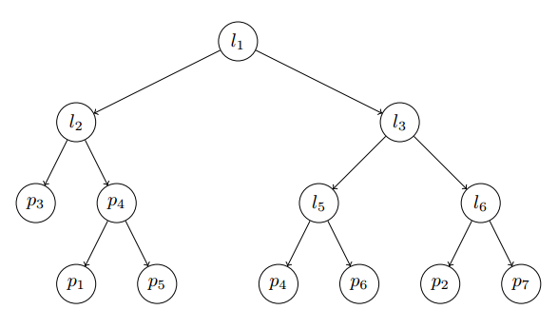
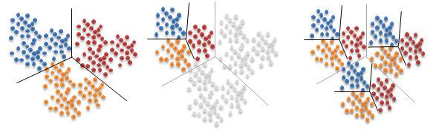
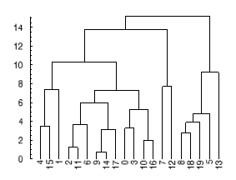
Find a Suitable Tool
Fast Libary for Approximate Nearest Neighbors (FLANN)

Slide 36
FLANN
 | Ground Truth | FLANN
Execution time [mins] | 279 | 17
Precision | 100% | 79%

Slide 37
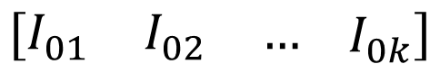
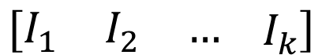
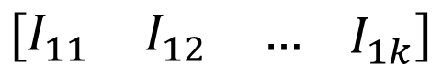
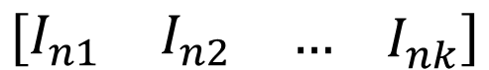
Implementation
Bucket 1
$$\left[\begin{matrix}I_{01} & I_{02} & …\end{matrix} I_{0k}\right]$$
Bucket 2
$$\left[\begin{matrix}I_{11} & I_{12} & …\end{matrix} I_{1k}\right]$$
Query Bucket
$$\left[\begin{matrix}I_{1} & I_{2} & …\end{matrix} I_{k}\right]$$
…
…
Bucket n
$$\left[\begin{matrix}I_{n1} & I_{n2} & …\end{matrix} I_{nk}\right]$$

Slide 38
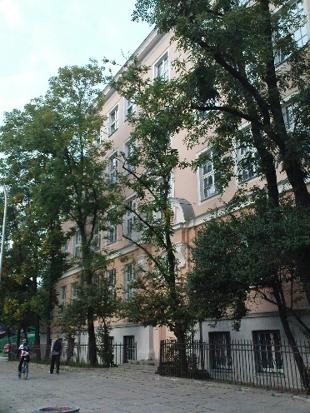
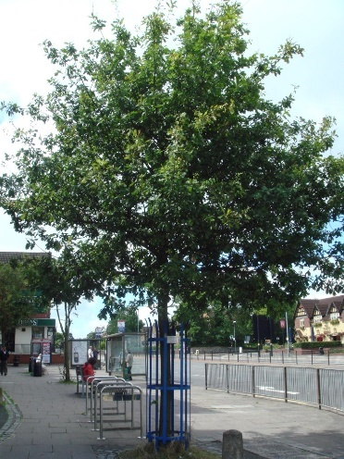
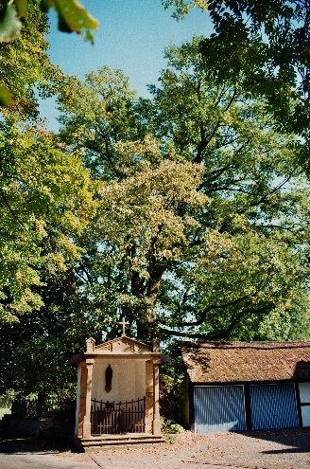
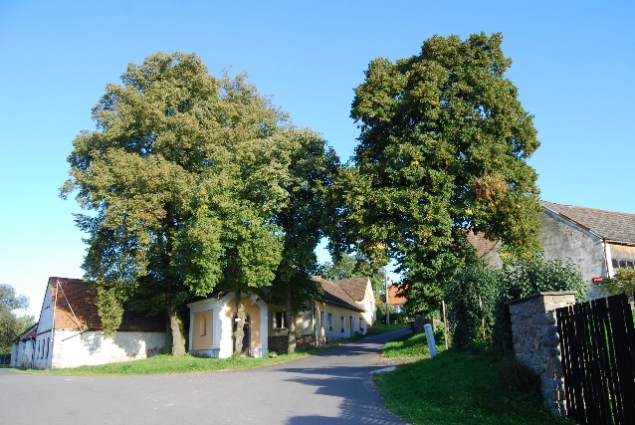
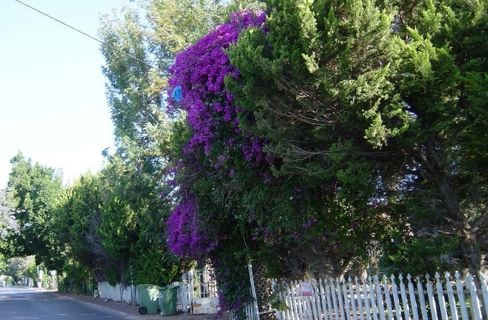
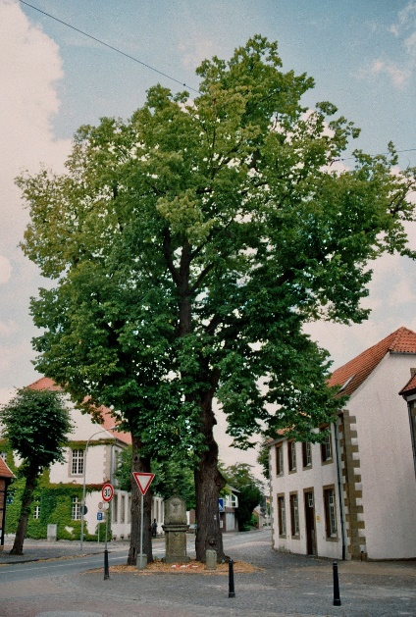
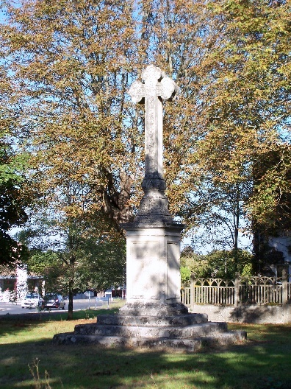

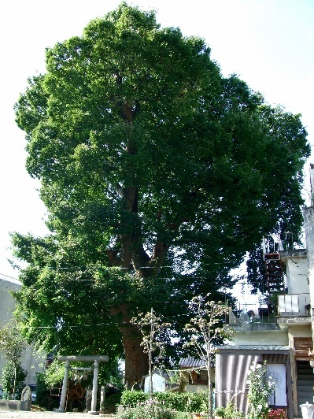
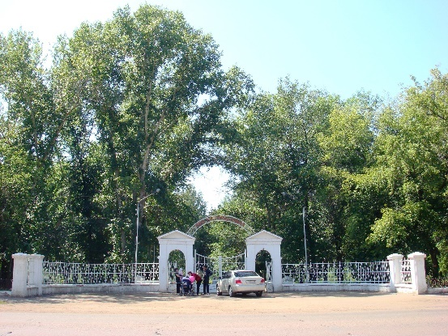
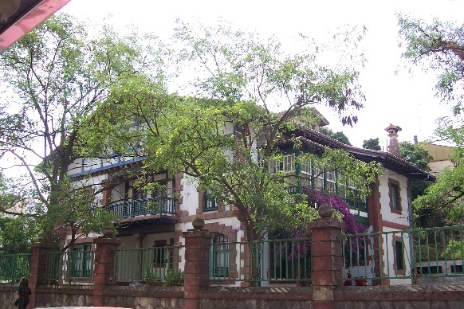
Results (HOG)

Slide 39
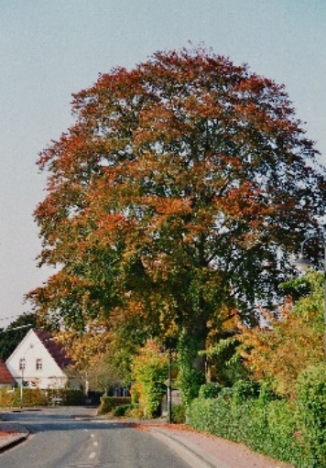
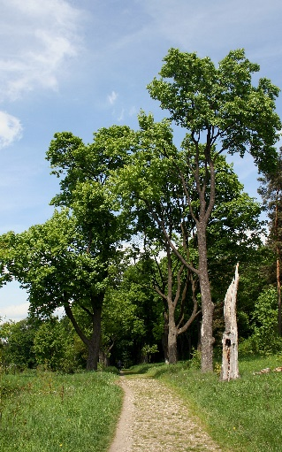
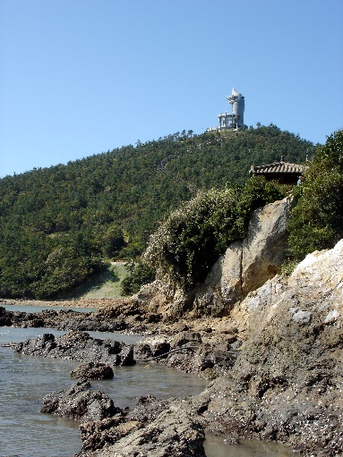
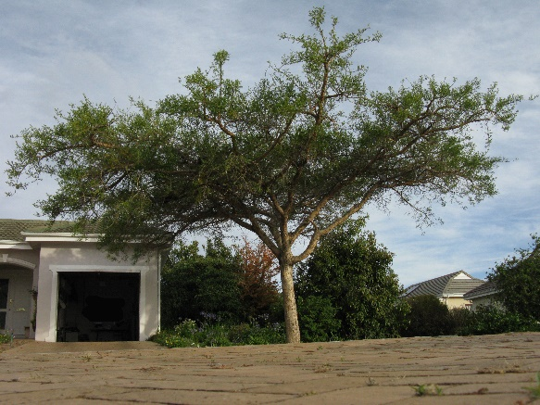
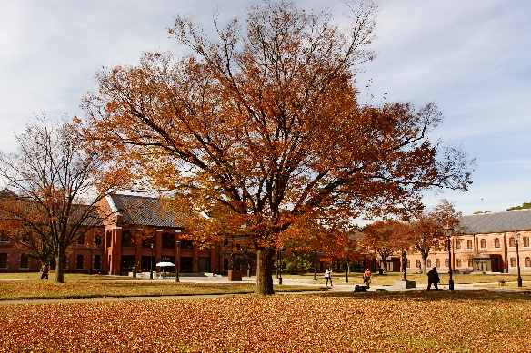
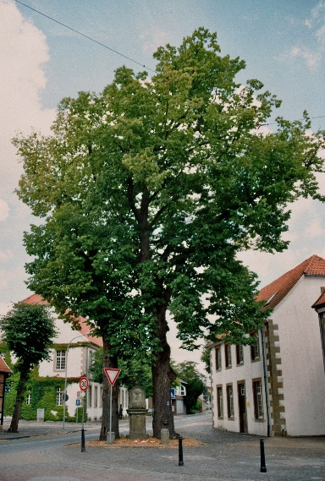
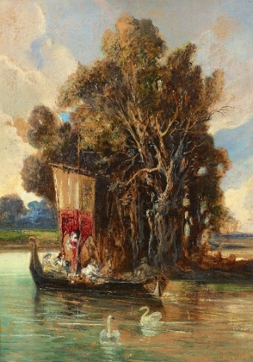
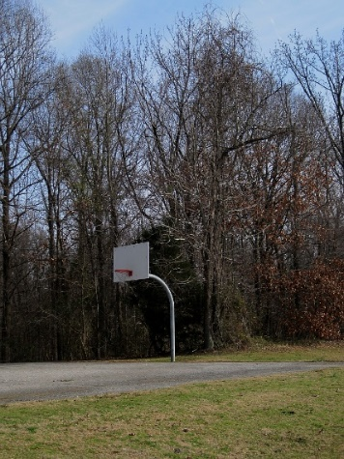
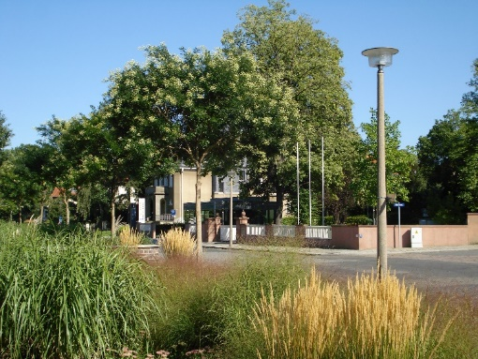
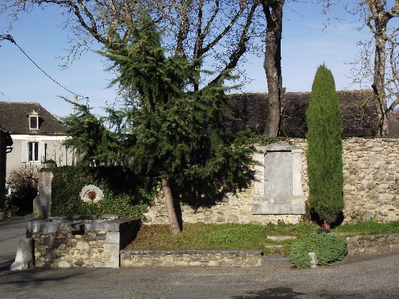

Results (GHD)

Slide 40






Results (CLD)

Slide 41











Results (CLD)

Slide 42
Summary
13 Hours
Computation time of k-NN per descriptor
3 Graphs
Containing similarity relations: 14.7M nodes, 150M edges each
442,959,000 Similarity Links
In total

Slide 43
6.
The Knowledge-Base

Slide 44

IMGpedia Ontology
imo:associatedWith

Slide 45

Links to DBpedia

Slide 46

Links to DBpedia
imo:associatedWith
db:Quentin_Tarantino

Slide 47

Links to DBpedia
imo:associatedWith
wd:Q3772
(Quentin Tarantino)

Slide 48


Parse Raw Data to RDF

Slide 49
14,765,300 Images
Visual Entities
44,295,900 Descriptors
3 descriptors per image
442,959,000 Similarity Links
Image Relations
19,297,667 Context Links
To Dbpedia and Wikidata

Slide 50
3,138,266,288
RDF Triples in IMGpedia

Slide 51

SPARQL Endpoint
imgpedia.dcc.uchile.cl/sparql
Notes:
Virtuoso server, provides endpoint anr URL rewrite tools for dereferencing IRIS

Slide 52

SPARQL Endpoint

Slide 53

Visual Entities Visualization

Slide 54
7.
The Results

Slide 55





Use-cases
SELECT DISTINCT ?Target
WHERE {
im:Hopsten_Marktplatz_3.jpg imo:similar ?Target .
}
Notes:
Obtaining similar images

Slide 56










Use-cases
SELECT DISTINCT ?Target ?Distance
WHERE {
?rel imo:sourceImage im:Hopsten_Marktplatz_3.jpg ;
imo:usesDescriptorType imo:GHD ;
imo:targetImage ?Target ;
imo:distance ?Distance .
}
ORDER BY ?Distance
11
11,2
11,6
11,9
11,9
11,9
12
12,1
12,1
12,2
Notes:
Obtaining a specific descriptor, sorted by distance

Slide 57

Use-cases

Slide 58

Use-cases

Slide 59

Use-cases

Slide 60

Use-cases

Slide 61

Use-cases

Slide 62
8.
The Publications

Slide 63

Ferrada et. al. AMW 2016

Slide 64


Ferrada et. al. ISWC Poster & Demo 2017

Slide 65


Ferrada et. al. ISWC 2017

Slide 66

Ferrada et. al. Wiki Workshop 2018

Slide 67
9.
The Conclusions

Slide 68
Conclusions
IMGpedia is a linked dataset that provides feature descriptors of images along with similarity relations among them

Slide 69
Conclusions
IMGpedia enables the combination of visual similarity queries with semantic queries
Notes:
Providing semantic image retrieval and visuosemantic queries

Slide 70
Conclusions
imo:associatedWith relation enables to combine information of IMGpedia with DBpedia and Wikidata facts, which can enrich the results

Slide 71
Conclusions
The underlying methodology can be reused. Code is freely available.

Slide 72
10.
The Future

Slide 73


Incorporate more descriptors
Train our own network?

Slide 74


Query-by-example and Indexing

Slide 75


Explore new relations among images
contains
sameObject

Slide 76

Identify objects/entities on images

Slide 77


Thanks!
Any questions?
You can find me at:
sferrada@dcc.uchile.cl
@ferradest

